Slide 1
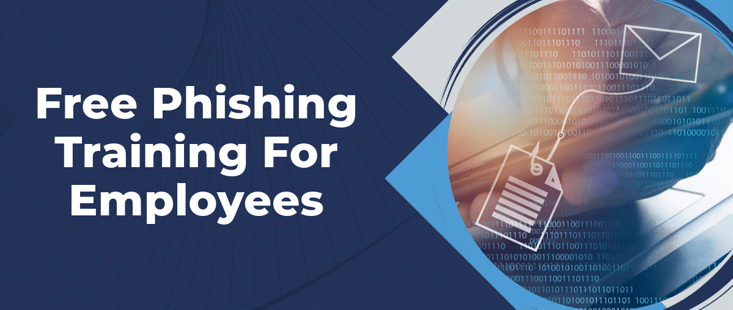
Phishing Awareness Training
Understanding Phishing Attacks & Prevention
Name: Zain Ul Abideen
Internship: CodeAlpha
Domain: Cybersecurity

Slide 2

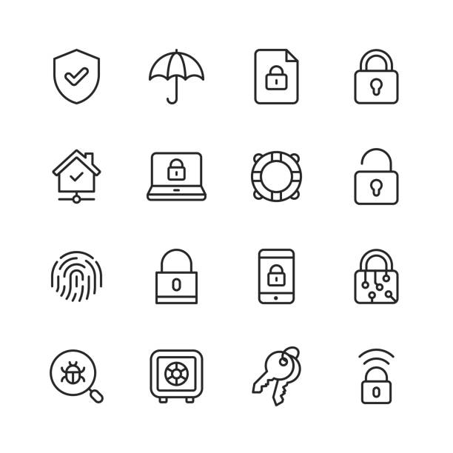
Learning Objectives
By the end of this training, you will be able to:
Understand what phishing is
Identify phishing emails, SMS, calls, and fake websites
Recognize social engineering techniques
Apply best practices to stay secure
Know how to report phishing incidents

Slide 3
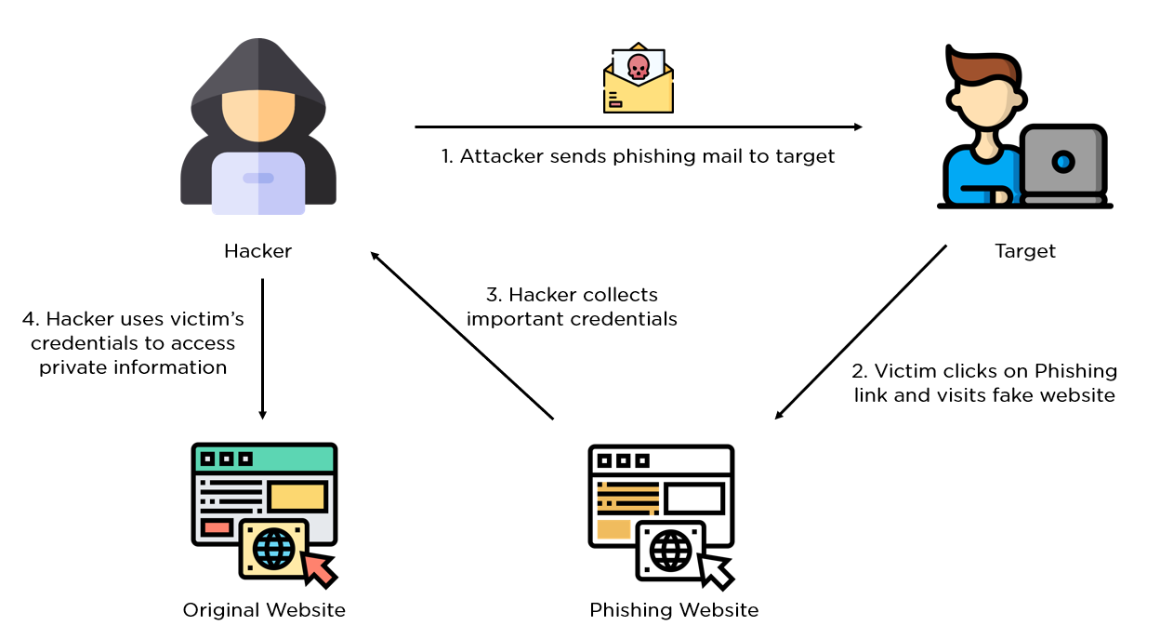





What is Phishing?
Phishing is a cyberattack where attackers impersonate trusted entities to steal sensitive information such as passwords, OTPs, and banking details.
Common phishing channels:
Email
SMS (Smishing)
Phone calls (Vishing)
Fake websites
Social media messages

Slide 4
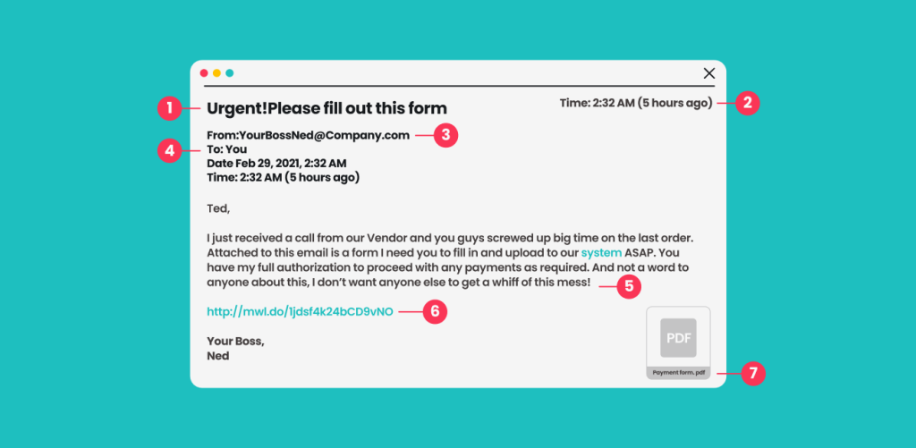



Email Phishing
Example:
"Your email account will be suspended within 24 hours. Click the link to verify now."
Red Flags:
Urgent language
Unknown sender
Suspicious links
Generic greeting

Slide 5
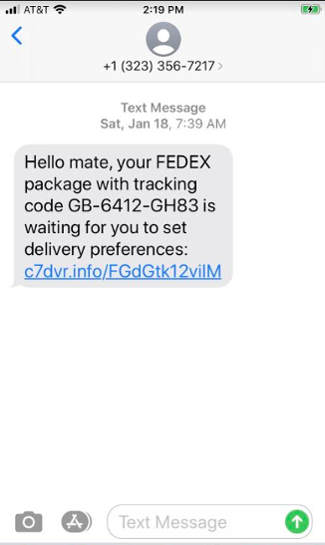



Smishing (SMS Phishing)
Example:
"Your bank card is blocked. Click here to reactivate immediately."
Warning Signs:
Shortened links
Urgent action request
Unknown number

Slide 6
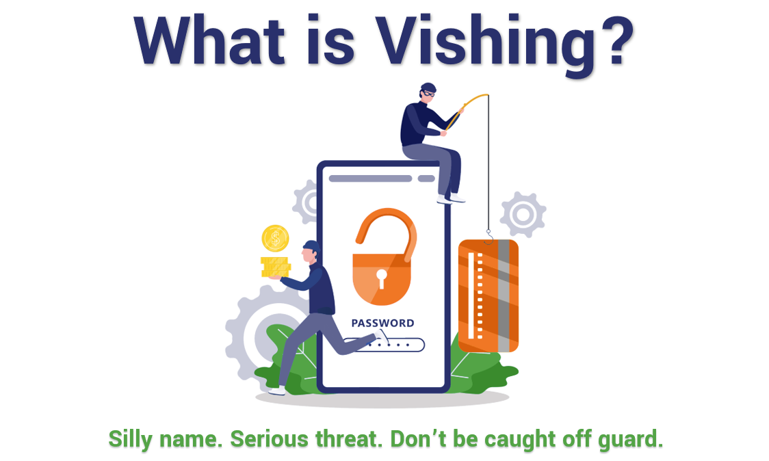



Vishing (Voice Phishing)
Example:
"This is your bank's fraud department. Share your OTP to secure your account."
Warning Signs:
Requests for OTP or PIN
Pressure or fear tactics
Caller claiming authority

Slide 7
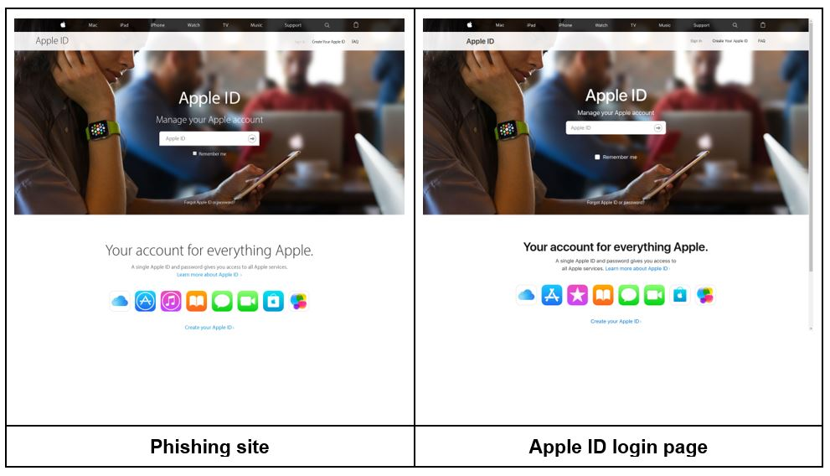



Fake Websites
Example:
Fake Microsoft login page using micros0ft-login[.]com
Signs of Fake Websites:
Misspelled domain names
No HTTPS
Poor design
Requests unnecessary credentials

Slide 8
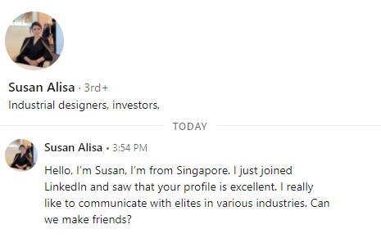



Social Media Phishing
Example:
"Congratulations! You are shortlisted for an interview. Click here for details."
Common Platforms:
LinkedIn
Instagram
Facebook

Slide 9


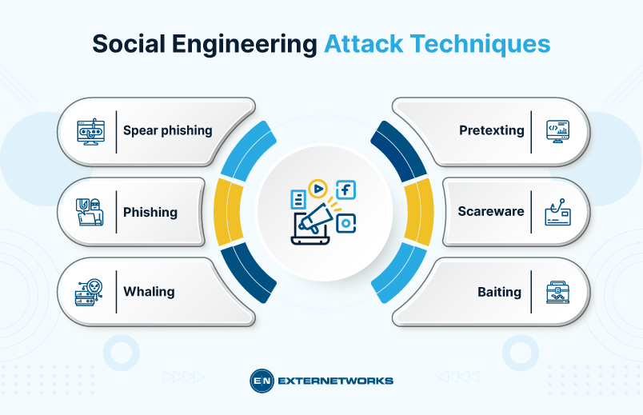



Social Engineering Techniques
Attackers manipulate human psychology using:
Authority - Impersonating trusted figures
Urgency - Creating time pressure
Fear - Threatening consequences
Trust - Building false relationships
Curiosity - Piquing interest with bait

Slide 10

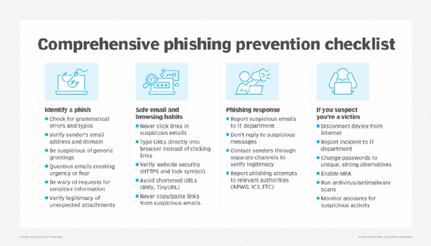






Best Practices to Avoid Phishing
Do:
Verify sender identity
Hover over links
Enable multi-factor authentication
Keep systems updated
Don't:
Click unknown links
Share OTPs or passwords

Slide 11


Knowledge Check – Match the Following
Match the attack type with the correct example:
Smishing SMS saying your card is blocked
Vishing Caller asking for OTP
Fake Website Fake login page stealing credentials
Social Media Phishing Fake job/interview message
Email Phishing Urgent verification email

Slide 12


Knowledge Check – Quick Question
Question:
You receive an urgent email from your bank asking you to click a link. What should you do?
A
Click immediately
B
Reply to the email
C
Visit official website manually
Correct Answer: C - Visit official website manually

Slide 13
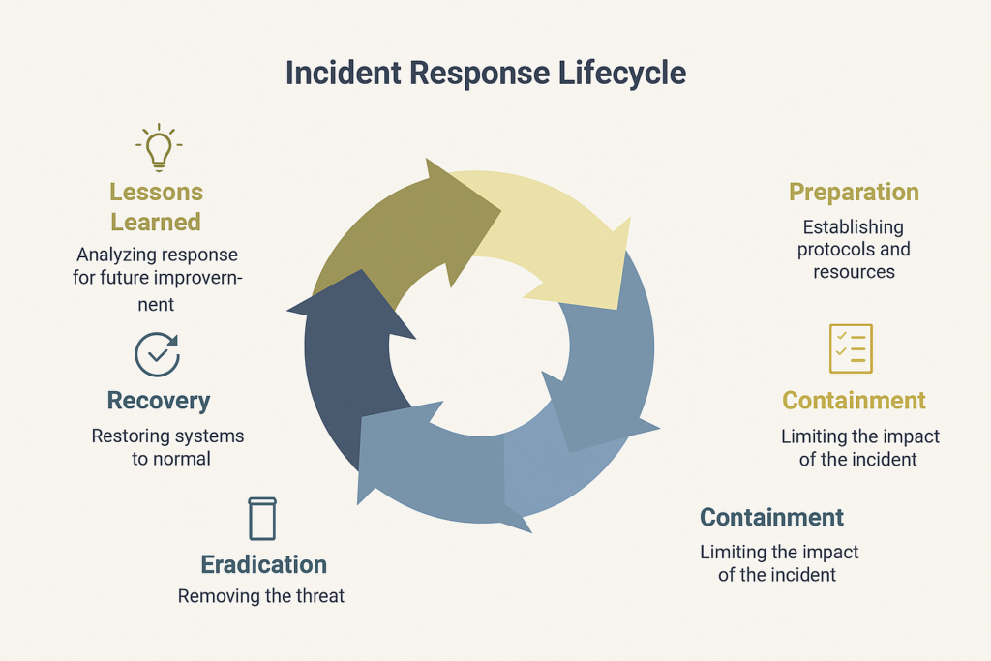





How to Report Phishing (Workflow)
Follow these steps when you encounter phishing:
1
Do not click links or attachments
2
Take a screenshot
3
Report to IT/SOC team
4
Delete the message
5
Change passwords if compromised

Slide 14

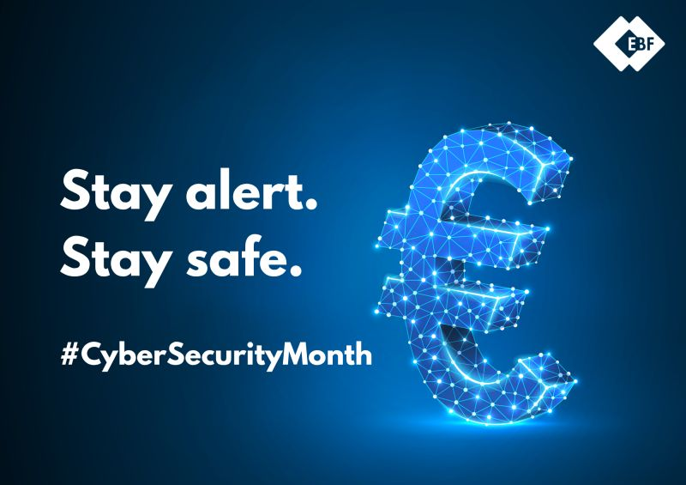



Conclusion
Phishing attacks are common but preventable
Awareness is the strongest defense
Always think before you click
Stay Alert. Stay Secure.

